Slide 1
Asynchronous Components with Futures: Semantics, Specification, and Proofs in a Theorem Prover
Ludovic Henrio
work realised with Muhammad Uzair Khan (+ Florian Kammuller)
Components (Distributed)
Futures
Formalisations (and proofs)
OASIS Team
CNRS – INRIA - UNS
Sophia Antipolis
France

Slide 2
Context and Objectives

Slide 3
What are (GCM) Components?
Bindings
Composite component
Client
interfaces
Server
interfaces
Primitive component
Business code
Primitive component
Business code
interface = port

Slide 4




Why a Mechanised Formalisation
Component model and definitions
Implementation
Optimizations
Generic
properties
Verification and tools
Optimizations
Properties are used in the implementation and the verification of programs

Slide 5



Why a Mechanised Formalisation
Component model and definitions
Implementation
Optimizations
Generic
properties
Verification and tools
Optimizations
Definitions and Properties are easy to check
definitions
properties
who checks the proofs?
Caromel, D., Henrio, L. A Theory of Distributed Object. Springer-Verlag (2005)

Slide 6




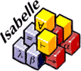
Why a Mechanised Formalisation
Component model and definitions
Implementation
Optimizations
Generic
properties
Verification and tools
Optimizations
definitions
properties
Only definitions and properties must be checked (+prover)

Slide 7
Our component model
Component model and definitions:
Grid Component Model [1]
structured, hierarchical, and distributed
support for runtime representation and manipulation
➔ handle reconfiguration, component structure
(separation between functional and non-functional concerns)
Based on the ProActive Java library
Developped in our team
based on Active Objects (Components monothreaded)
Composite component
Primitive component
Business code
Implementation: ProActive/GCM
Primitive component
Business code
[1] Françoise Baude, Denis Caromel et al, GCM: A Grid Extension to Fractal for Autonomous Distributed Components, in Annals of Telecommunications - Special Issue on Software Components - The Fractal Initiative, Springer, 2009

Slide 8
Our objectives
definition
From a model more precise than GCM (structure), but more general than ProActive/GCM implementation
In a theorem prover ➔ Mechanized proofs
To study
  interaction between futures and components,
  correctness of adaptation procedures and optimisations done in the library
Here: Prove correctness of
future update strategies
➔ proofs about the middleware
properties
A future is a placeholder for a promised result

Slide 9
Component Structure

Slide 10
Encode GCM basic component structure
Bindings
Composite component
Client
interfaces
Server
interfaces
Primitive component
Business code
Primitive component
Business code
interface = port

Slide 11
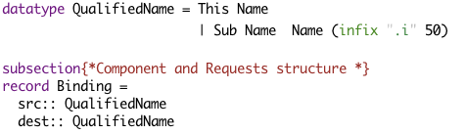
Framework for Reasoning on Components
Component hierarchical Structure
For example, bindings:
Composite component
Primitive component
Business code
Design Choices
  Suitable abstraction level
  Suitable representation
  List / Finite Set, component name, etc
Primitive component
Business code

Slide 12
Support Constructs and Lemmas
Operators to manipulate components inside hierarchies
  E.g., Traverse hierarchy: find/replace,
  (recursive) set of subcomponents: cpSet
To manipulate states
  Retrieve referenced futures, all computed results, etc
Properties on component structure
  “Well-defined” and “correct” Components
Support lemmas, e.g.

Slide 13

Component re-configuration
Transformation of component structure or content at runtime
  Two reconfiguration primitives formalised (remove and replace)
  Illustrates the flexibility of the approach
Basic properties on reconfiguration primitives
Ludovic Henrio, Florian Kammüller, and Muhammad Uzair Khan
A Framework for Reasoning on Component Composition - FMCO 2009, Springer (2010)

Slide 14
Communication Model

Slide 15
A Primitive GCM Component
CI
CI.foo(p)
Primitive components communicating by asynchronous requests on interfaces
Components abstract away distribution and concurrency

Slide 16
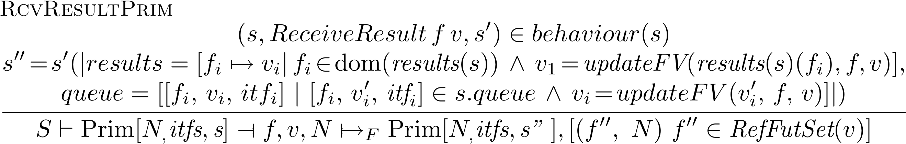
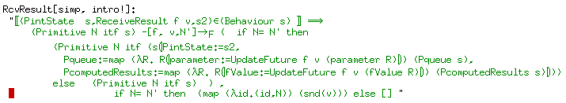
Primitive Components in Isabelle
Primitive components are defined by interfaces plus an internal behaviour, they can:
  emit requests
  serve requests
  send results
  receive results (at any time)
  do internal actions
  some rules define a
  correct behaviour,
  e.g. one can only send result for a served request
We define the behaviour of the whole components as small-step operational semantics

Slide 17
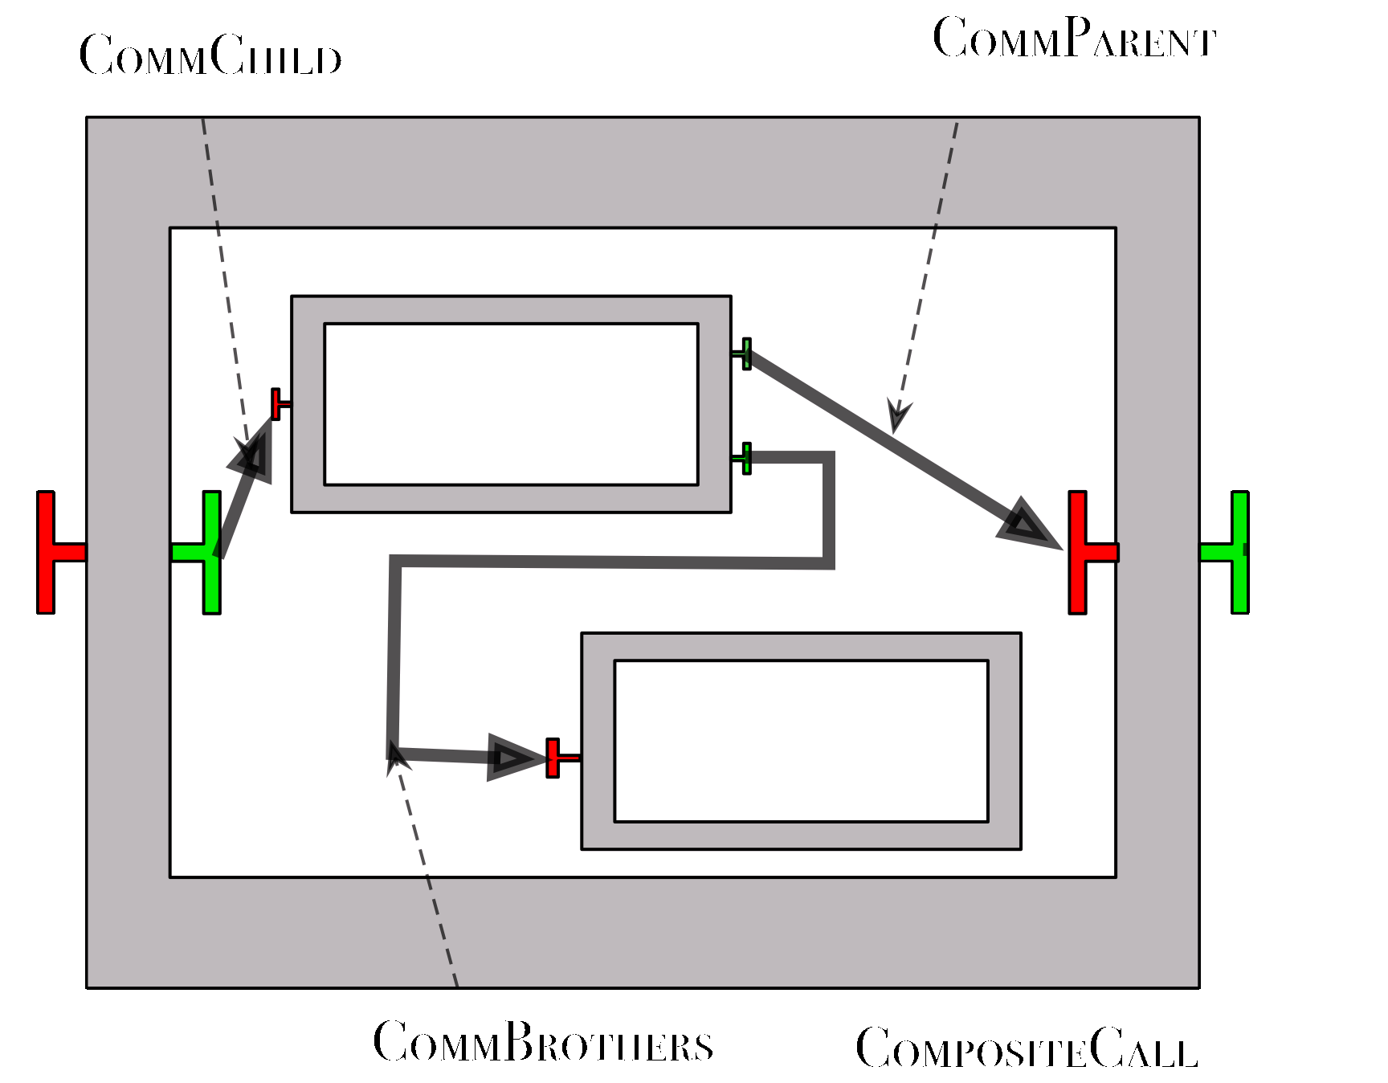
Communication inside Composites
Composites only delegate calls between components
Use the bindings to know where to transmit requests
Composite behaviour expressed as small step semantics
and encoded in Isabelle

Slide 18
Futures

Slide 19
Futures
Future = Placeholder for an awaited result
  Result of concurrent computation
Example:
  Futures in Multilisp [1]
  ( Cons (future A) ( future B) )
  Separate threads for evaluating A and B
(future A)
(future B)
A
B
[1] Halstead, Jr., R.H. Multilisp: A language for concurrent symbolic computation. ACM Transactions on Programming Languages and Systems (TOPLAS), 1985

Slide 20
Futures: Classification
Creation of a future
  How and when are futures created?
    Implicit creation = automatic upon asynchronous invocation (on a remote object)
    Explicit creation = there is a future construct
Manipulation and access
  How to manipulate the futures?
    Explicit access = get operation (+ future type)
    Implicit (transparent) access = any variable can contain a future

Slide 21
Futures for Components
f=CI.foo(p)
……….
g=f+3
g=f+3
Component are independent entities
(threads are isolated in a component)
+
Asynchronous requests with results
⬇
Futures are necessary

Slide 22

First-class Futures
…
…
…
f=CI.foo(p)
CI.foo(f)
CI.foo(f)
Only strict operations are blocking (access to a future)
Communicating a future is not a strict operation

Slide 23
First-class Futures and Hierarchy
return C1.foo(x)
… … …
Without first-class futures, one thread is systematically blocked in the composite component.
A lot of blocked threads

Slide 24
Future Update Strategies

Slide 25
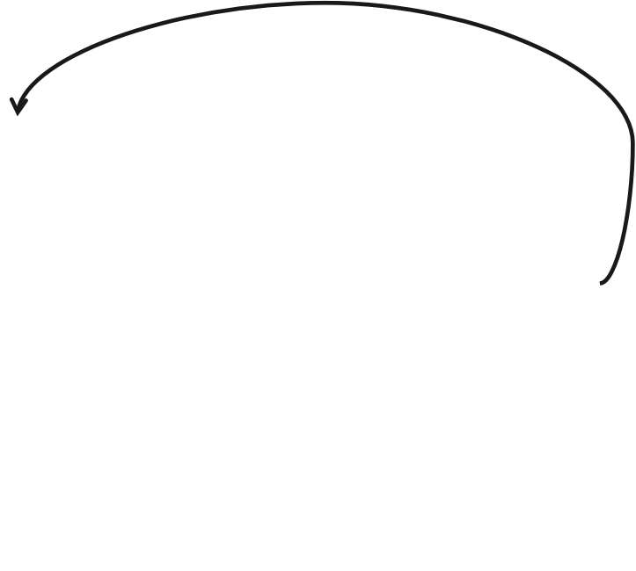
Future Update Strategies
How to bring future values to components that need them?
A “naive” approach: Any component can receive a value for a future reference it holds.
More operational is the lazy approach:
require future value
Lazy future update -- « On demand »
No-unnecessary transfer of values
Two phases update: « registration delay + time for transfer »
Results stored for long term ➔ Not much operational.

Slide 26
Eager forward-based strategy
A strategy avoiding to store future values indefinitely
Future updates follow the same path as future flow
Each component remembers only the components to which it forwarded the future
Results sent as soon as available
No additional message
Future updates form a chain ➔ intermediate components
Easy to garbage collect computed results

Slide 27
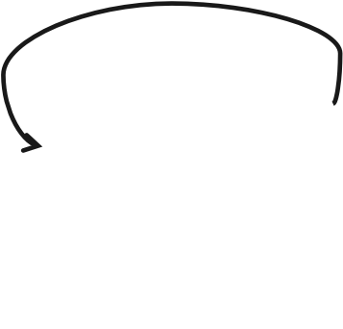
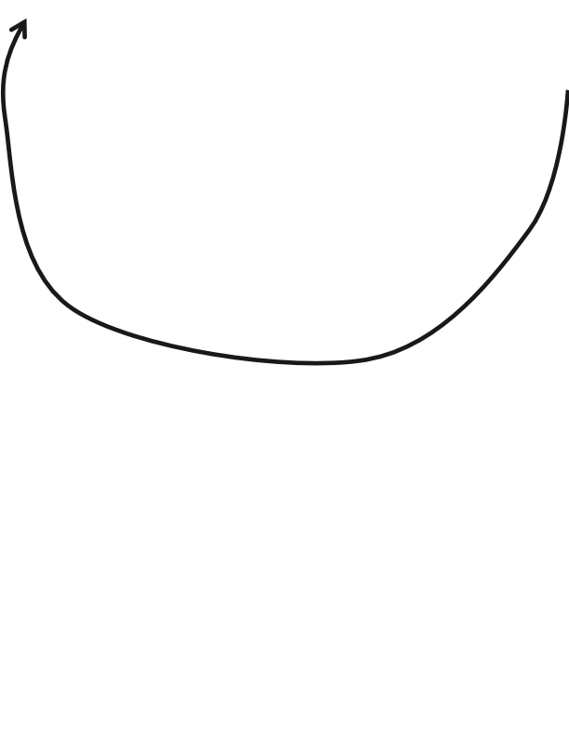
Eager home-based future update
A strategy avoiding to store future values indefinitely
Relies on future registration and sends the value as soon as it is calculated
register future
Results sent as soon as available
Every component with future reference is registered
Un-necessary transfers
Garbage collection of computed results possible
Formalised in Isabelle
register future

Slide 28
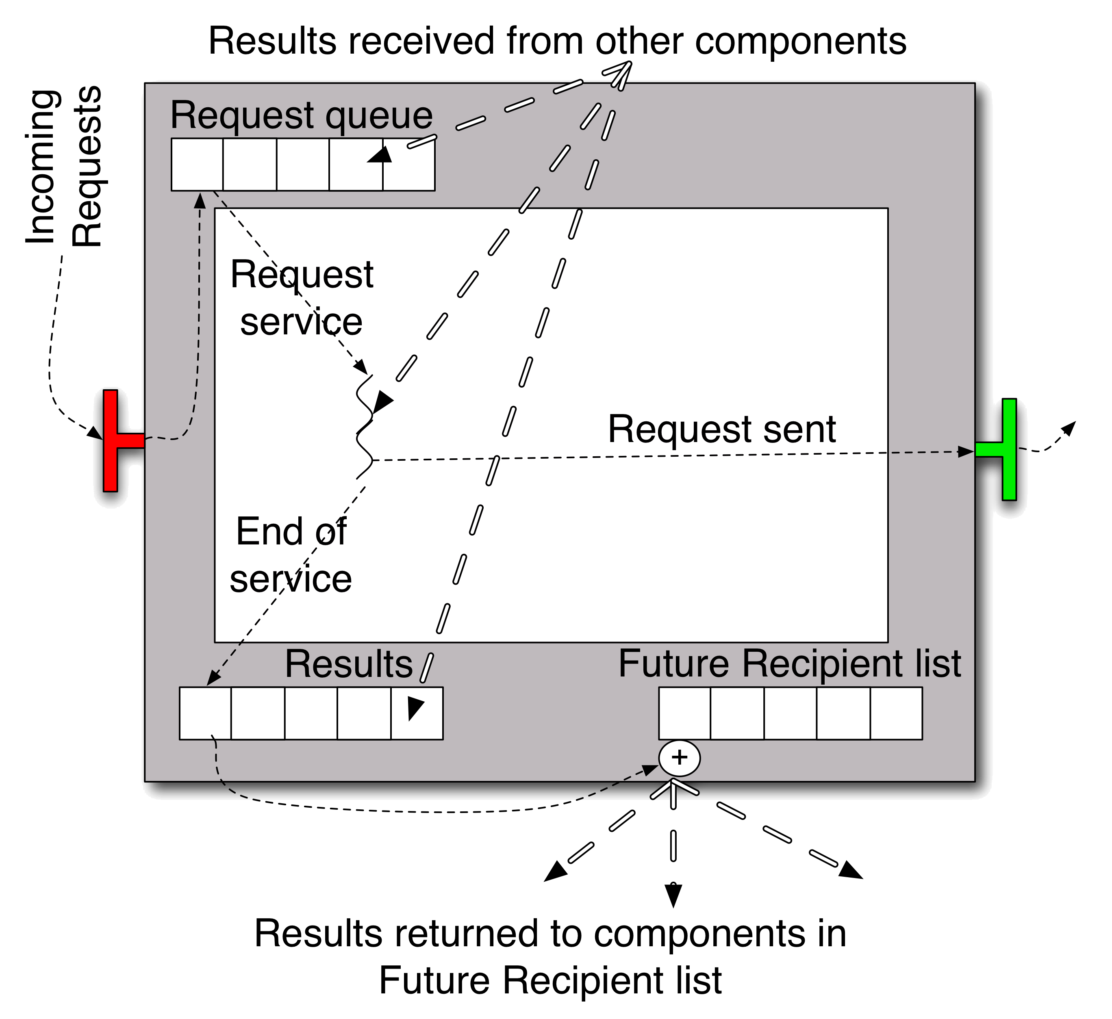
GCM-like Component with Eager-home

Slide 29
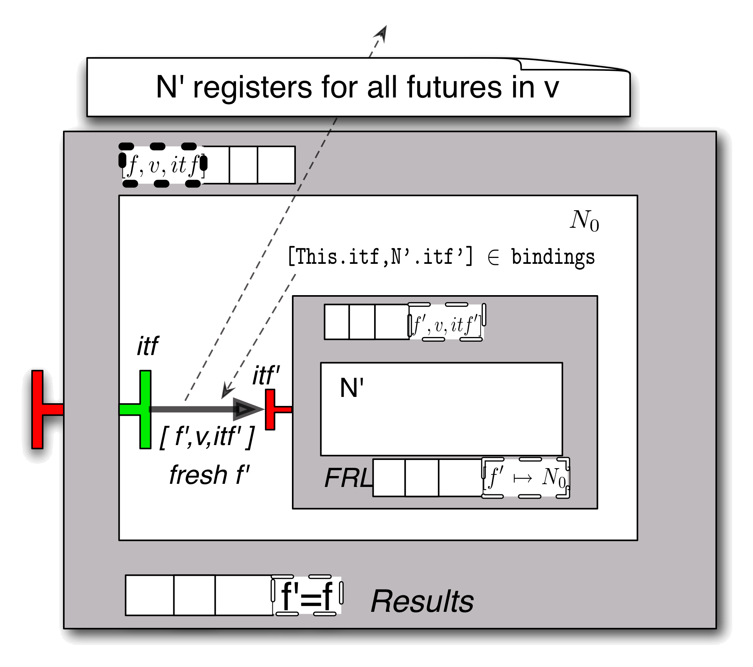
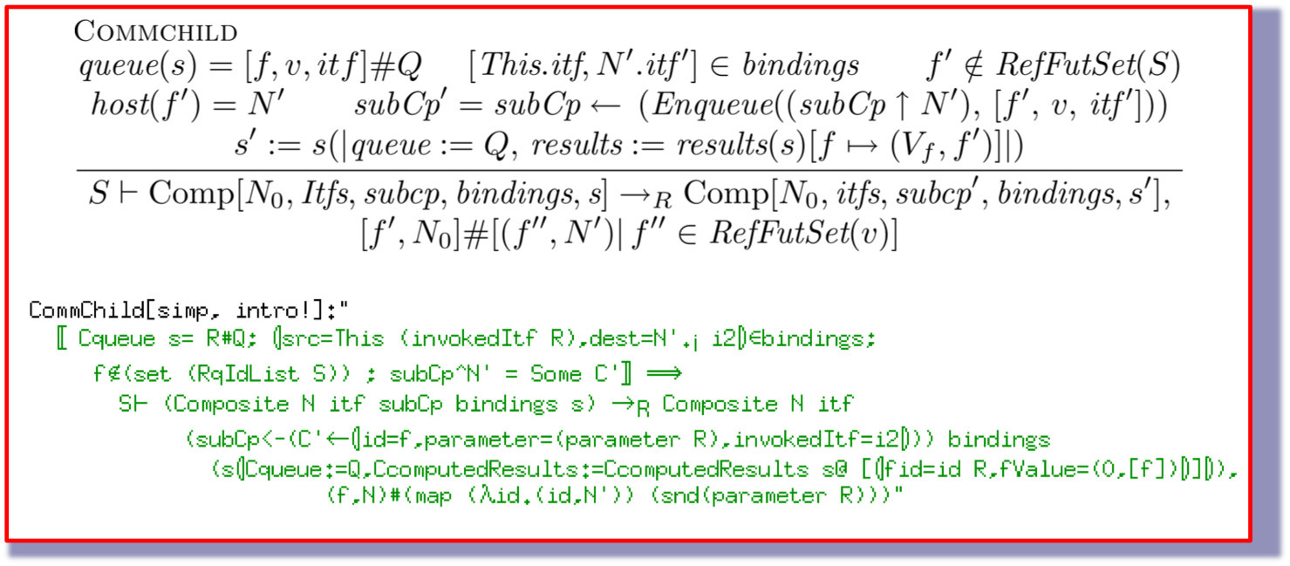
Composite Component Semantics –CommChild

Slide 30

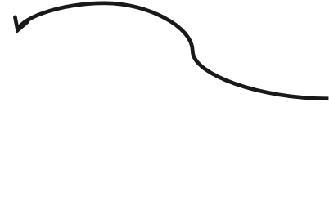
Properties on Future updates
Generic
properties
Future updates remove all references to a given future
All Future references are registered during reduction
Garbage collectable
Complete
registration
register future
Ludovic Henrio and Muhammad Uzair Khan “Asynchronous Components with Futures: Semantics and Proofs in Isabelle/HOL” - FESCA 2010 - ENTCS

Slide 31
CONCLUSION

Slide 32
Formalisation in Isabelle
> 4000 lines, mostly proofs (do not read the proofs!)
Almost 300 lemmas and theorems,
~ 500 lines definitions: component model and semantics
1800 lines for future update specific properties
A few tricky design choices (lists vs sets, how to store names, …)
A couple of axioms remaining (reduction correctness)
short-term goal: correctness of various strategies
Longer term: reconfiguration and execution

Slide 33
A refined GCM model
definition
More precise than GCM, give a semantics to the model:
  asynchronous communications: future / requests
  request queues
  no shared memory between components
  notion of request service
Less precise than ProActive/GCM
  can be multithreaded
  no active object, not particularly object-oriented
Similarities with: SCA and Fractal (structure),
Creol (futures)

Slide 34
Conclusion
Components
  GCM-like Component Model
  Hierarchal components / interfaces / bindings / …
First class futures
  For asynchronous communication
  Future update strategies
Formalization in Isabelle/HOL
  Formal specification + one future update strategy
  Tools (lemmas + constructs) for manipulating components + futures
  Proofs of correctness for future update and registration
A framework for mechanical proofs about components
Formal constructs to study: components, futures, reconfiguration, …

Slide 35
THANK YOU !

Slide 36
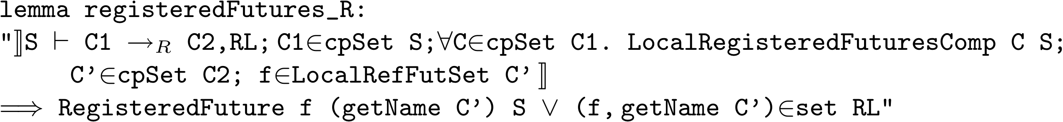
Auxiliary lemmas
Registered futures are preserved during reduction
Futures references from a subcomponent in C2 are either registered in S or are in RL
Basic lemmas

Slide 37
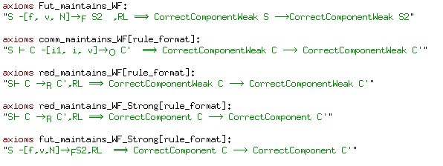
Remaining axioms

